Slide 1

Chapter 4 Network Layer:
Data Plane
Computer Networking: A Top-Down Approach 8th edition Jim Kurose, Keith Ross Pearson, 2020
Acknowledgement: Based on the textbook’s website: https://gaia.cs.umass.edu/kurose_ross/index.php
Notes:
Version History
8.0 (May 2020)
All slides reformatted for 16:9 aspect ratio
All slides updated to 8th edition material
Use of Calibri font, rather that Gill Sans MT
Add LOTS more animation throughout
added new 8th edition material on middleboxes (and Internet arch), Net neutrality, buffering …
lighter header font
8.2 (July 2023), changes from 8.0:
some minor updates (e.g., IPv6 stats updated) but not much has changed.

Slide 2

Network layer: “data plane” roadmap
Network layer: overview
data plane
control plane
What’s inside a router
input ports, switching, output ports
buffer management, scheduling
IP: the Internet Protocol
datagram format
addressing
network address translation
IPv6
Generalized Forwarding, SDN
Match+action
OpenFlow: match+action in action
Middleboxes

Slide 3
Router architecture overview
IMPORTANT
high-level view of generic router architecture:
routing, management
control plane (software)
operates in millisecond
time frame
routing
processor
forwarding data plane (hardware) operates in nanosecond timeframe
high-speed
switching
fabric
router input ports
router output ports

Slide 4



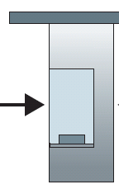

Router architecture overview
IMPORTANT
analogy view of generic router architecture:
routing, management
control plane (software)
operates in millisecond
time frame
Station manager
forwarding data plane (hardware) operates in nanosecond timeframe
roundabout
entry stations
exit roads
Notes:
We can easily recognize the principal router components in Figure 4.4 in this analogy—the entry road and entry station correspond to the input port (with a lookup function to determine to local outgoing port); the roundabout corresponds to the switch fabric; and the roundabout exit road corresponds to the output port. With this analogy, it’s instructive to consider where bottlenecks might occur. What happens if cars arrive blazingly fast (for example, the roundabout is in Germany or Italy!) but the station attendant is slow? How fast must the attendant work to ensure there’s no backup on an entry road? Even with a blazingly fast attendant, what happens if cars traverse the roundabout slowly—can backups still occur? And what happens if most of the cars entering at all of the roundabout’s entrance ramps all want to leave the roundabout at the same exit ramp—can backups occur at the exit ramp or elsewhere? How should the roundabout operate if we want to assign priorities to different cars, or block certain cars from entering the roundabout in the first place? These are all analogous to critical questions faced by router and switch designers.

Slide 5


Input port functions
IMPORTANT
lookup,
forwarding
queueing
line
termination
link
layer
protocol
(receive)
switch
fabric
physical layer:
bit-level reception
Datagram
decentralized switching:
using header field values, lookup output port using forwarding table in input port memory (“match plus action”)
goal: complete input port processing at ‘line speed’
input port queuing: if datagrams arrive faster than forwarding rate into switch fabric
link layer:
e.g., Ethernet
(chapter 6)
Frame
Notes:
Green box is a physical layer responsible for receiving bit level transmission. Copper, fiber wireless.
Link layer in blue – bit assemble into Ethernet frame. We will discuss this in details in chapter 6.
But most critical one, is here. Lookup, forwarding function. Lookup and forward is “Match plus action” behavior.
GOAL – processing at “line speed”, otherwise, buffer will be full and packet will be lost

Slide 6
Input port functions
IMPORTANT
lookup,
forwarding
queueing
line
termination
link
layer
protocol
(receive)
switch
fabric
physical layer:
bit-level reception
decentralized switching:
using header field values, lookup output port using forwarding table in input port memory (“match plus action”)
destination-based forwarding: forward based only on destination IP address (traditional)
generalized forwarding: forward based on any set of header field values
link layer:
e.g., Ethernet
(chapter 6)

Slide 7
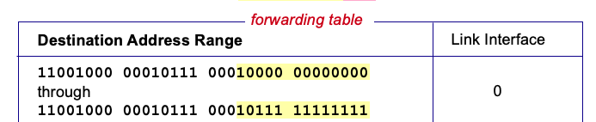

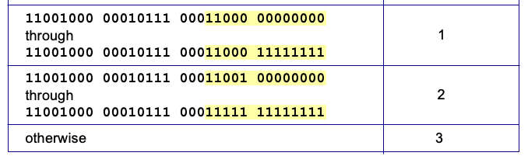
Destination-based forwarding
IMPORTANT
3
Q: but what happens if ranges don’t divide up so nicely?
Notes:
Text for this animation:
This all works out pretty nice and looks pretty simple!
But of course the devil is in the details, as the saying goes.
What happens, for example, when a subset of addresses say in this first range should go to say interface 3, rather than interface 0. Well, of course we could split the first address range into multiple pieces, and add in this new subrange with its new destination output port. But it turns out there’s a much simpler and elegant way to do this. Known as longest prefix matching.

Slide 8
Longest prefix matching
IMPORTANT
longest prefix match
when looking for forwarding table entry for given destination address, use longest address prefix that matches destination address.
Destination Address Range
11001000 00010111 00010
11001000 00010111 00011000
11001000 00010111 00011
otherwise
Link interface
0
1
2
3
***
********
********
***
********
examples:
11001000 00010111 00010110 10100001
which interface?
11001000 00010111 00011000 10101010
which interface?

Slide 9
Longest prefix matching
IMPORTANT
longest prefix match
when looking for forwarding table entry for given destination address, use longest address prefix that matches destination address.
Destination Address Range
11001000 00010111 00010
11001000 00010111 00011000
11001000 00010111 00011
otherwise
Link interface
0
1
2
3
***
********
********
match!
***
********
examples:
11001000 00010111 00010110 10100001
which interface?
11001000 00010111 00011000 10101010
which interface?

Slide 10
Longest prefix matching
IMPORTANT
longest prefix match
when looking for forwarding table entry for given destination address, use longest address prefix that matches destination address.
Destination Address Range
11001000 00010111 00010
11001000 00010111 00011000
11001000 00010111 00011
otherwise
Link interface
0
1
2
3
***
********
********
***
********
match!
examples:
11001000 00010111 00010110 10100001
which interface?
11001000 00010111 00011000 10101010
which interface?

Slide 11
Longest prefix matching
IMPORTANT
longest prefix match
when looking for forwarding table entry for given destination address, use longest address prefix that matches destination address.
Destination Address Range
11001000 00010111 00010
11001000 00010111 00011000
11001000 00010111 00011
otherwise
Link interface
0
1
2
3
***
********
********
***
********
match!
examples:
11001000 00010111 00010110 10100001
which interface?
11001000 00010111 00011000 10101010
which interface?

Slide 12
Longest prefix matching
IMPORTANT
we’ll see why longest prefix matching is used shortly, when we study addressing
longest prefix matching: often performed using ternary content addressable memories (TCAMs)
content addressable: present address to TCAM: retrieve address in one clock cycle, regardless of table size
Cisco Catalyst: ~1M routing table entries in TCAM

Slide 13
Switching fabrics
IMPORTANT
transfer packet from input link to appropriate output link
switching rate: rate at which packets can be transfer from inputs to outputs
often measured as multiple of input/output line rate
N inputs: switching rate N times line rate desirable
R
(rate: NR, ideally)
R
. . .
high-speed
switching
fabric
. . .
N input ports
N output ports
R
R

Slide 14
Switching fabrics
IMPORTANT
transfer packet from input link to appropriate output link
switching rate: rate at which packets can be transfer from inputs to outputs
often measured as multiple of input/output line rate
N inputs: switching rate N times line rate desirable
three major types of switching fabrics:
memory
memory
bus
interconnection
network

Slide 15
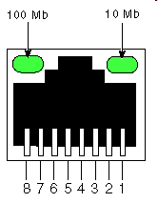
Switching via memory
IMPORTANT
first generation routers:
traditional computers with switching under direct control of CPU
packet copied to system’s memory
speed limited by memory bandwidth (2 bus crossings per datagram)
input
port
(e.g.,
Ethernet)
output
port
(e.g.,
Ethernet)
memory
system bus

Slide 16
Switching via a bus
IMPORTANT
datagram from input port memory to output port memory via a shared bus
bus contention: switching speed limited by bus bandwidth
32 Gbps bus, Cisco 5600: sufficient speed for access routers

Slide 17
Switching via interconnection network
IMPORTANT
Crossbar, Clos networks, other interconnection nets initially developed to connect processors in multiprocessor
multistage switch: nxn switch from multiple stages of smaller switches
3x3 crossbar
3x3 crossbar
exploiting parallelism:
fragment datagram into fixed length cells on entry
switch cells through the fabric, reassemble datagram at exit
8x8 multistage switch
built from smaller-sized switches

Slide 18
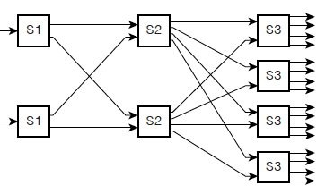
Switching via interconnection network
IMPORTANT
scaling, using multiple switching “planes” in parallel:
speedup, scaleup via parallelism
Cisco CRS router:
basic unit: 8 switching planes
each plane: 3-stage interconnection network
up to 100’s Tbps switching capacity
fabric plane 0
fabric plane 1
fabric plane 2
. . .
. . .
fabric plane 3
. . .
. . .
fabric plane 4
. . .
. . .
fabric plane 5
. . .
. . .
fabric plane 6
. . .
. . .
fabric plane 7
. . .
. . .
. . .
. . .
. . .
. . .

Slide 19
Input port queuing
IMPORTANT
If switch fabric slower than input ports combined -> queueing may occur at input queues
queueing delay and loss due to input buffer overflow!
Head-of-the-Line (HOL) blocking: queued datagram at front of queue prevents others in queue from moving forward
switch
fabric
switch
fabric
output port contention: only one red datagram can be transferred. lower red packet is blocked
one packet time later: green packet experiences HOL blocking

Slide 20

Output port queuing
IMPORTANT
datagram
buffer
queueing
This is a really important slide
switch
fabric
(rate: NR)
link
layer
protocol
(send)
line
termination
R
Buffering required when datagrams arrive from fabric faster than link transmission rate. Drop policy: which datagrams to drop if no free buffers?
Datagrams can be lost due to congestion, lack of buffers
Scheduling discipline chooses among queued datagrams for transmission
Priority scheduling – who gets best performance, network neutrality

Slide 21
Output port queuing
IMPORTANT
switch
fabric
switch
fabric
at t, packets more
from input to output
one packet time later
buffering when arrival rate via switch exceeds output line speed
queueing (delay) and loss due to output port buffer overflow!

Slide 22
How much buffering?
RFC 3439 rule of thumb: average buffering equal to “typical” RTT (say 250 msec) times link capacity C
e.g., C = 10 Gbps link: 2.5 Gbit buffer
more recent recommendation: with N flows, buffering equal to
.
RTT C
N
but too much buffering can increase delays (particularly in home routers)
long RTTs: poor performance for real-time apps, sluggish TCP response
recall delay-based congestion control: “keep bottleneck link just full enough (busy) but no fuller”
Notes:
You might think that more buffering is a good thing. Buffering is a bit like salt—just the right amount of salt makes food better, but too much makes it inedible!

Slide 23
Buffer Management
buffer management:
drop: which packet to add, drop when buffers are full
tail drop: drop arriving packet
priority: drop/remove on priority basis
datagram
buffer
queueing
scheduling
switch
fabric
link
layer
protocol
(send)
line
termination
R
Abstraction: queue
marking: which packets to mark to signal congestion (ECN, RED)
R
packet
departures
packet
arrivals
queue
(waiting area)
link
(server)

Slide 24
Packet Scheduling: FCFS
IMPORTANT
packet scheduling: deciding which packet to send next on link
first come, first served
priority
round robin
weighted fair queueing
FCFS: packets transmitted in order of arrival to output port
also known as: First-in-first-out (FIFO)
real world examples?
Abstraction: queue
R
packet
departures
packet
arrivals
queue
(waiting area)
link
(server)

Slide 25
Scheduling policies: priority
IMPORTANT
Priority scheduling:
arriving traffic classified, queued by class
any header fields can be used for classification
high priority queue
arrivals
classify
link
departures
low priority queue
2
send packet from highest priority queue that has buffered packets
FCFS within priority class
1
3
4
5
arrivals
packet in service
1
3
2
4
5
departures
1
3
2
4
5

Slide 26
Scheduling policies: round robin
IMPORTANT
Round Robin (RR) scheduling:
arriving traffic classified, queued by class
any header fields can be used for classification
server cyclically, repeatedly scans class queues, sending one complete packet from each class (if available) in turn
R
classify
arrivals
link
departures

Slide 27
Scheduling policies: weighted fair queueing
IMPORTANT
Weighted Fair Queuing (WFQ):
generalized Round Robin
each class, i, has weight, w_{i}, and gets weighted amount of service in each cycle:
w₁
w₂
R
w_{i}
Σ_{j}w_{j}
classify
arrivals
link
departures
w₃
minimum bandwidth guarantee (per-traffic-class)

Slide 28
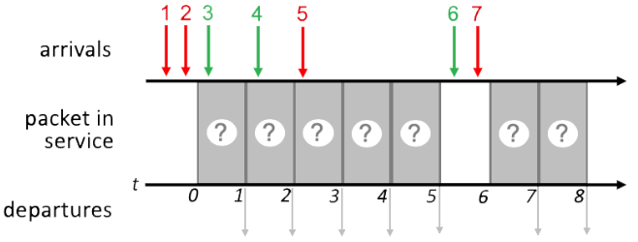
Quiz
IMPORTANT

Slide 29
FCFS Scheduling
IMPORTANT
Transmit order the same as packet arrival order of 1 2 3 4 5 6 7
1
2
3
4
5
6
7
1
2
3
4
5
6
7
1 2 3 4 5 6 7

Slide 30
Priority Scheduling
IMPORTANT
Time 0: 1, 2 in queue, transmit 1
FCFS within same priority
Time 1: 2, 3 in queue, transmit 2
Time 2: 3, 4 in queue, transmit 3
FCFS within same priority
Time 3: 4, 5 in queue, transmit 5
Time 4: 4 in queue, transmit 4
Time 6: 6, 7 in queue, transmit 7
Time 7: 6 in queue, transmit 6
1
2
3
5
4
7
6
1
2
3
5
4
7
6
1 2 3 5 4 7 6
Network Layer: 4-30

Slide 31
Round Robin Scheduling
IMPORTANT
Red starts each round if there are both red and green packets ready to transmit after an empty slot, i.e., (red, green) in each round
Time 0-1: 1st round: (1, 3)
Time 2-3: 2nd round: (2, 4)
Time 4-5: 3rd round: (5, null)
No green packets ready
Time 6-7: 4th round: (7, 6)
1
3
2
4
5
7
6
1
3
2
4
5
7
6
1 3 2 4 5 7 6

